Slide 1
12th session.
Introduction to financial management: the balance sheet
Notes:
We will deal with financial topics slowly because, finally, we have to use numbers for things.

Slide 2
Balance
Assets
Liabilities and equity
Fixed
Assets
Equity
Long-term
liabilities
Current
Assets
Current
liabilities
Notes:
Spend many time in this slide and explain the initial balance of Bar Pepe S.L.

Slide 3
Financial Management: Goals
To have enough treasury (to avoid and prevent situations of liquidity constraints)
  Treasury plan
At a minimum cost (including the opportunity cost)
  Income statement
With an optimum financial balance
  Balance sheet
Notes:
Why you must be very careful with this topic. All this can only be done after having explained well Bar Pepe, S.L. and the balance. In fact, we have explained this before and we can go quick through these slides.

Slide 4
Financial Management: Difficulties
Contradiction between goals: we need to search an optimum.
Imperfect information: the work is based on forecasts.
Growth problem.
Inflation problem.
Notes:
Problems which arise, comment them. All this can only be done after having explained well Bar Pepe, S.L. and the balance. In fact, we have explained this before and we can go quick through these slides.

Slide 5
What do we have to do?
Keep control over the financial structure
Keep the financial structure stable.
Proactive management of seasonality.
Notes:
Comment. All this can only be done after having explained well Bar Pepe, S.L. and the balance. In fact, we have explained this before and we can go quick through these slides.

Slide 6
Basic criteria
Finance every asset through instruments which have a similar life span.
  For example, it is not prudent to finance a building with a one-year credit. (Are there any exceptions?)
How to finance current assets?
Notes:
Comment. All this can only be done after having explained well Bar Pepe, S.L. and the balance. In fact, we have explained this before and we can go quick through these slides. Come back to the Bar Pepe example. Put the example of a developer’s loan as an exception.

Slide 7
Corporate debt: advantages
It makes business management easier because it allows less planning.
It facilitates access to resources which would be otherwise rarely available for the company.
Allows increasing profitability on your own resources.
Helps to finance growth.
Allows getting time for people who is in trouble.
Notes:
Comment. All this can only be done after having explained well Bar Pepe, S.L. and the balance. In fact, we have explained this before and we can go quick through these slides. Come back to the Bar Pepe example. Put examples.

Slide 8
Corporate debt: disadvantages
Increase of risk for shareholders.
Increase of risk for stakeholders.
Allows survival to directors who do not plan.
Allows starting non profitable projects.
Allows hiding financial problems, even for those who might solve them.
Notes:
Comment. Come back to the Bar Pepe example. Put examples.

Slide 9
Corporate debt (comparing situations)
 |  | A |  |  | B
Sales | 100 | 80 | 60 | 100 | 80 | 60
Cost of Goods Sold | 60 | 48 | 36 | 60 | 48 | 36
General & Administration Expenses | 20 | 20 | 20 | 20 | 20 | 20
Financial Expenses (15%) | 0 | 0 | 0 | 7,5 | 7,5 | 7,5
Profit before tax | 20 | 12 | 4 | 12,5 | 4,5 | -3,5
Tax | 7 | 4,2 | 1,4 | 4,375 | 1,575 | 0
Net Profit | 13 | 7,8 | 2,6 | 8,125 | 2,925 | -3,5
Return on Equity | 13% | 7,8% | 2,6% | 16,25% | 5,85% | -7,00%
Identical assets with a value of 100. Company A: 0% debt. Company B: 50% debt
Notes:
Comment calmly this slide which has a good explicative capacity. Domino pieces in the blackboard and the slide.

Slide 10
Financing current assets
The problem of growth
Notes:
Come back to Bar Pepe, S.L. Put examples. Current assets are important because can generate short-term issues

Slide 11
What are current assets?
Cash
Banks
Customers (accounts receivable)
Finished products
Raw materials
Notes:
Come back to Bar Pepe, S.L. Put examples.

Slide 12
Why do we refer to it like Current assets?
Because they are entries which vary continuously.
However, the average amount of current assets is relatively stable
Notes:
Come back to Bar Pepe, S.L. Put examples.

Slide 13
The main restriction
Current assets
Current liabilities
Cash
Banks
Accounts receivable
Finished products
Raw materials
Outstanding Salaries
Suppliers
Short-term credits
Other short-term debts
Working capital > 0 ???
Notes:
Come back to Bar Pepe, S.L. Put examples. Talk about examples of large distribution to see that this is not always true.

Slide 14
Why is the Management of Current Assets important?
Because an error might leave us in a very dangerous and difficult treasury constraint situation
Because financing them is expensive
Because it grows quickly in new companies
  ... but current liabilities grow even quicker
Notes:
Comment. It is a key point in our business plan because it is a new company.

Slide 15
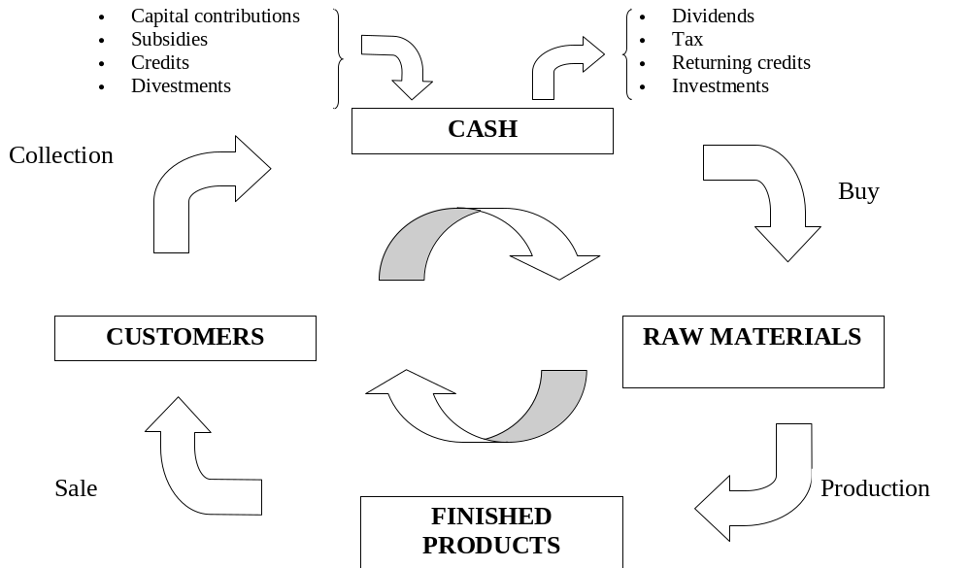
Current Assets cycle
Notes:
Comment. Very relevant. Come back to Bar Pepe, S.L. Put examples

Slide 16
How to finance the Current Assets?
Like other assets: with resources or instruments which a similar life span
Current liabilities can only partially finance us
The Working capital must be financed with Equity
  … if we do not want to run into too many risks
Notes:
Comment the domino pieces and the global financing of assets. Come back to Bar Pepe, S.L. Put examples

Slide 17
Growth problem (1)
Sales Buy
But if we pay before having collected ...
Liabilities quicker than current assets
Danger of strangulating liquidity which can lead us to a real problem ...
  for having sold too much!
Notes:
Comment and put examples. Come back to Bar Pepe, S.L. for examples

Slide 18
Growth problem (2)
Credit as a solution?
Problems:
    It distorts the financial structure
    It increases risk
    You only get more time
Notes:
Comment. Put examples.

Slide 19
Growth problem (3)
Optimal solution: pay late and collect early
Capital Increases
Other Own Resources: reinvest
Sustainable growth depends of the reinvested margin
  g = ROE * (1-p)
Notes:
Come back to Bar Pepe, S.L. for examples. Comment another time the large distribution.

Slide 20
Sustainable growth
g = ROE * (1-p)
g = sustainable growth (% annual sales)
ROE = return on equity
ROE = (r + (r-i) D/E) where:
    r = PBT/Assets
    D = Debt
    E= Equity
    i = interest rates after tax
p = dividend/net profit
Notes:
Interesting. Comment calmly.

